Slide 1

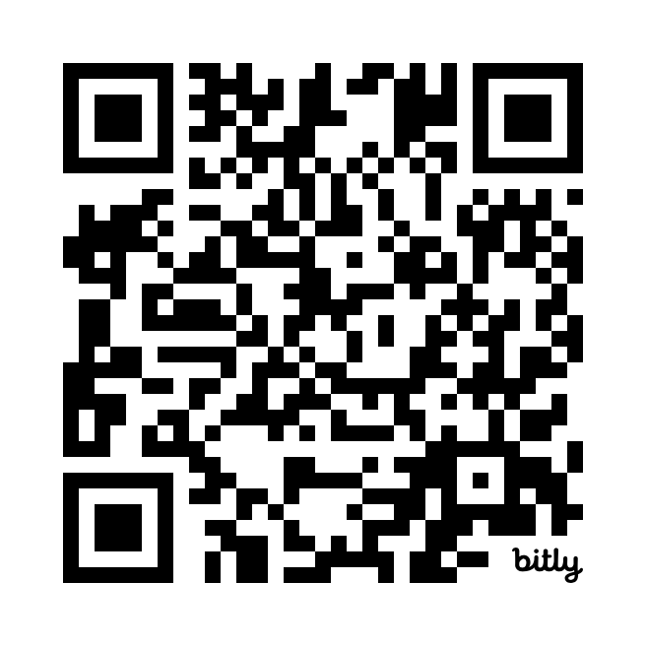


Taverners Hill Infant School,
Petersham
September 16th 2024
Please register your attendance for this workshop

Slide 2


Housekeeping
Phones to a minimum
Name tags
Register attendance
You’re encouraged to take photos
Media request
‹#›

Slide 3
Agenda Tonight
Time | Activity | Notes
6pm | Introduction & Workshop Part 1 | Build your Fresk together – a participatory and hands-on card game. Phase 1: Understanding Phase 2: Creativity & Summary
7:30pm | Bring out meals
7:40pm | Workshop Part 2 | Participatory, less hands on. Phase 3: Emotions Phase 4: Actions Commitments
8:55pm | Close
‹#›

Slide 4
Acknowledgement of Country
I’d like to begin by acknowledging the Traditional Owners of the land on which we meet today.
I would also like to pay my respects to Elders past, present and emerging.
‹#›

Slide 5
Icebreaker
Hello 👋
What’s your name?
What’s your happy moment of the week?
What’s your level of knowledge on Climate Change on a 1 to 5 scale?
What’s your current level of individual and collective action on Climate Change on a 1 to 5 scale?
‹#›

Slide 6
Introduction to Climate Fresk
Climate Fresk is a LEARNING workshop led by a community of ‘Freskers’
Created in France in 2015
Based on a game with 42 cards taken from the scientific reports of the IPCC.
‹#›

Slide 7

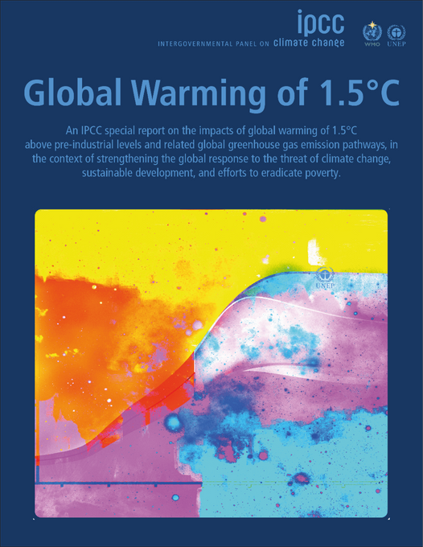
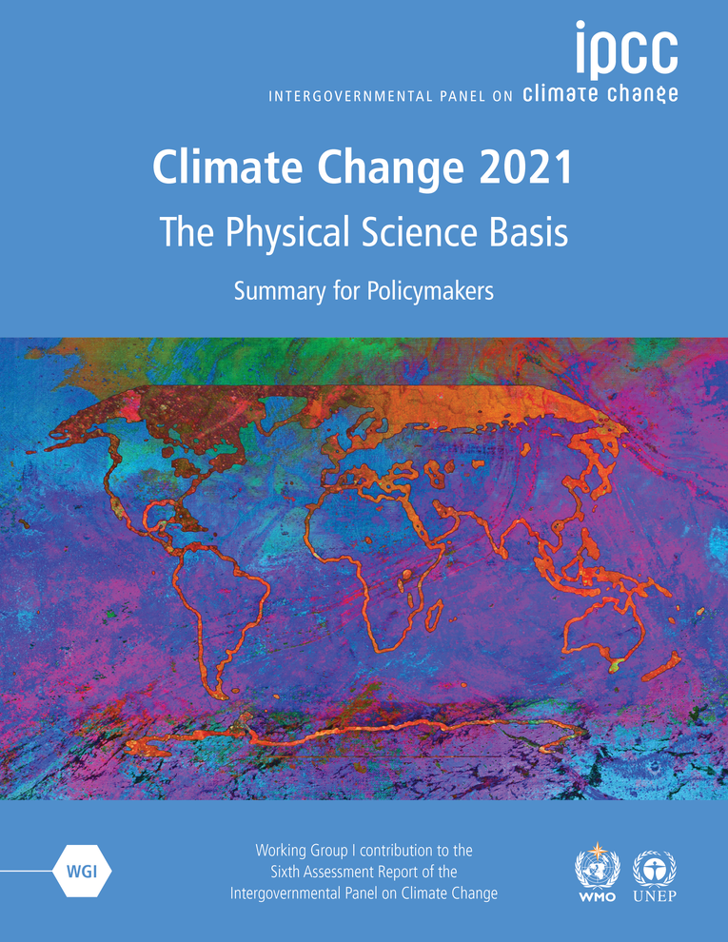
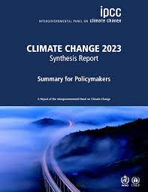
  1988 - The UN created the IPCC
  2013-2014: 5th Assessment Report (AR5)
  2018: Special Report: Global Warming of 1.5°C
  2021-2023: 6th Assessment Report (AR6)
‹#›

Slide 8
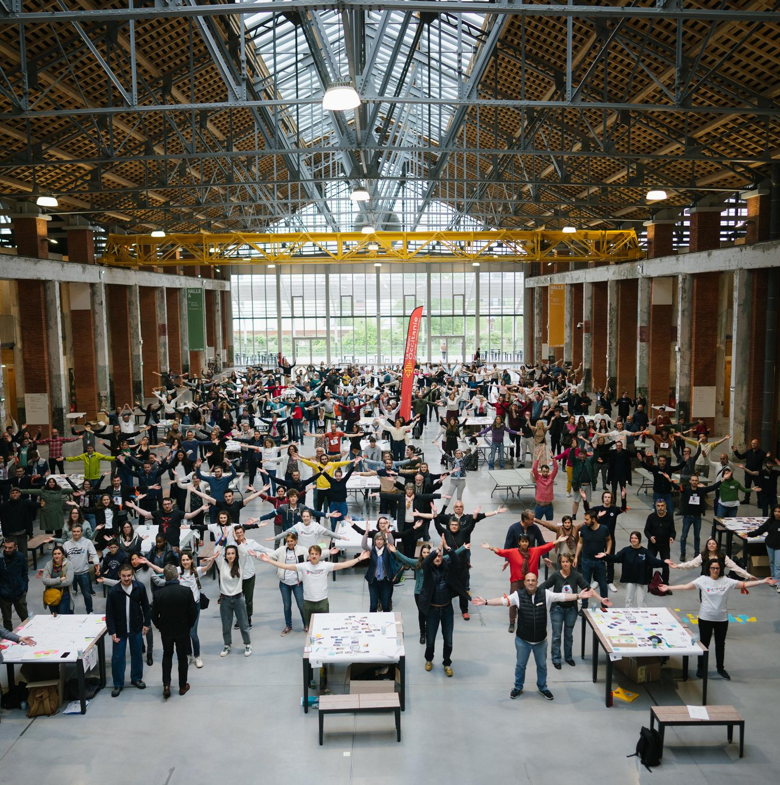





+1.8 million
participants globally
1000’s
organisations globally – businesses, education, non-profit
83k
facilitators
150
countries
45
languages
‹#›
Notes:
add graph for australia

Slide 9
Norms for being together
Blinders off
Be present
Step up, step back
OK, let’s Fresk!
‹#›

Slide 10
Phase 1 Understanding
‹#›

Slide 11
Phase 2
Creativity & Summary
‹#›

Slide 12
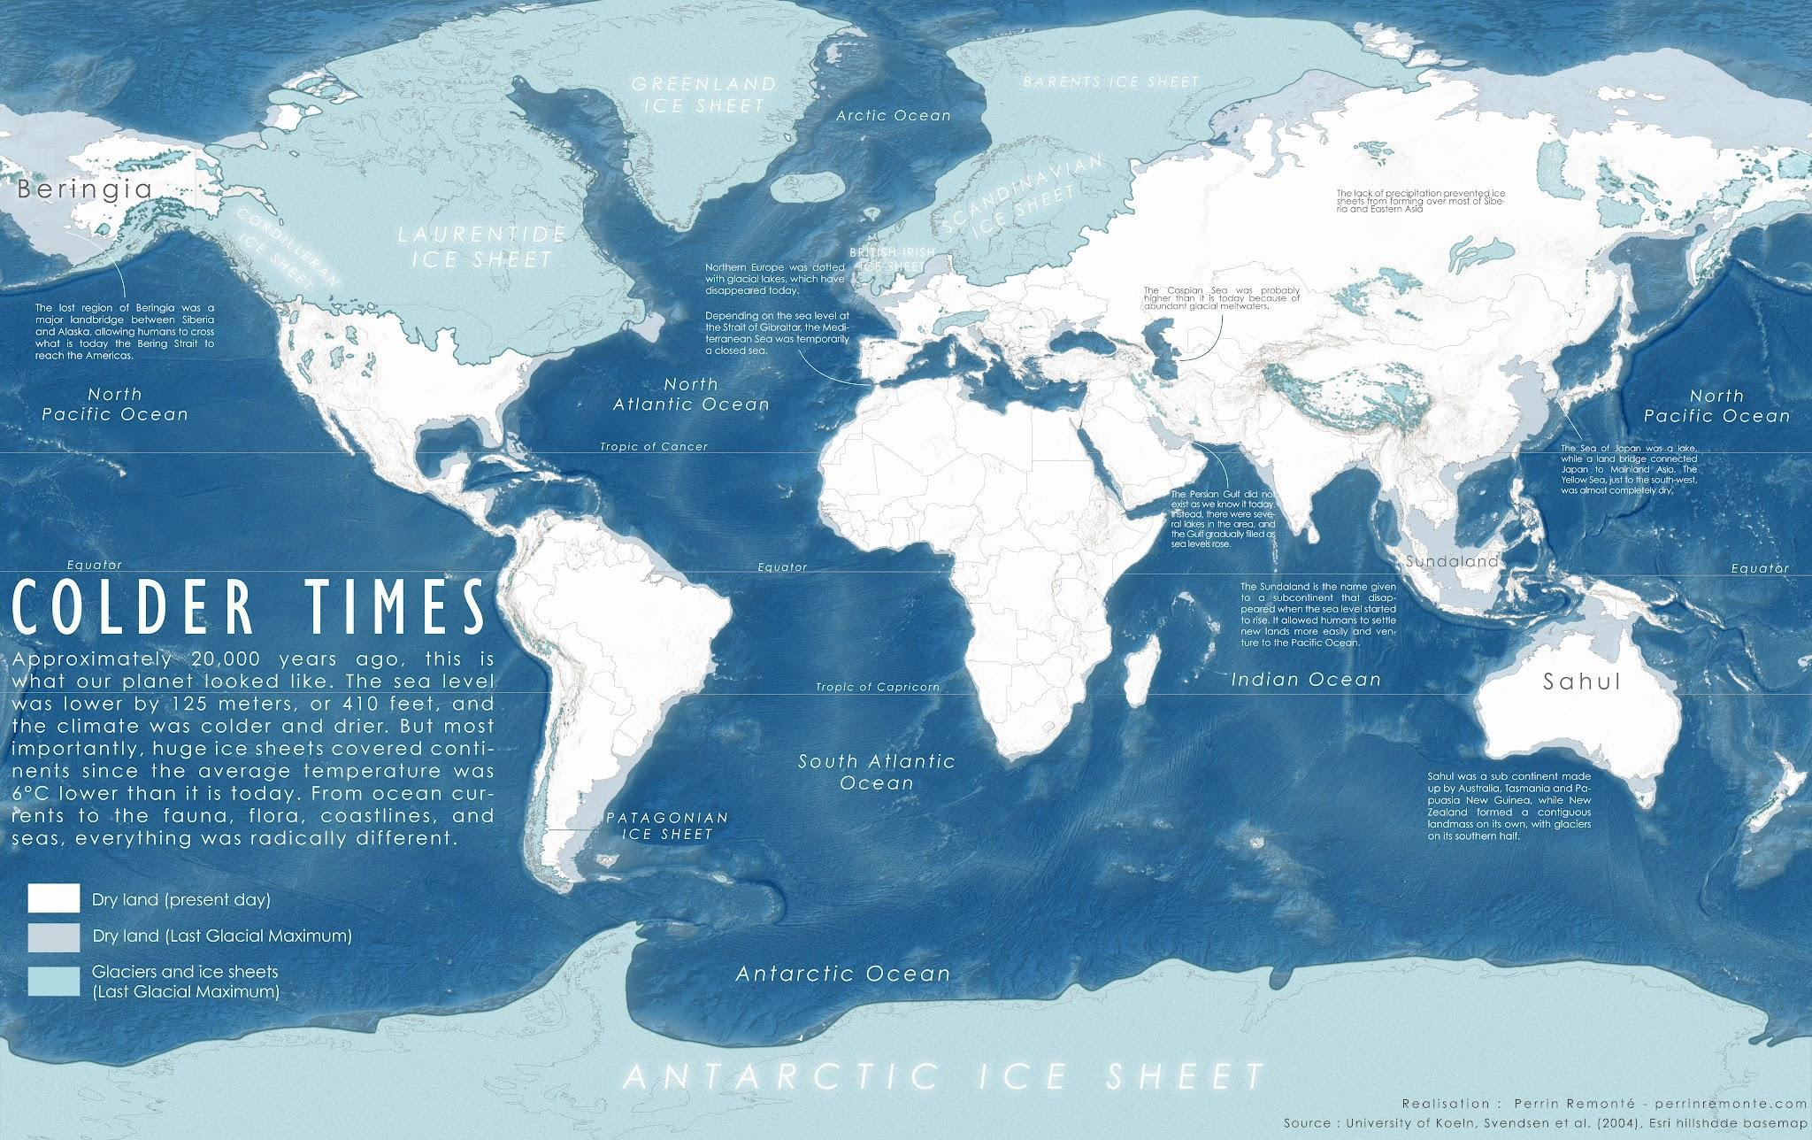
How much colder was the last ice age?
6ºC lower than today
‹#›

Slide 13
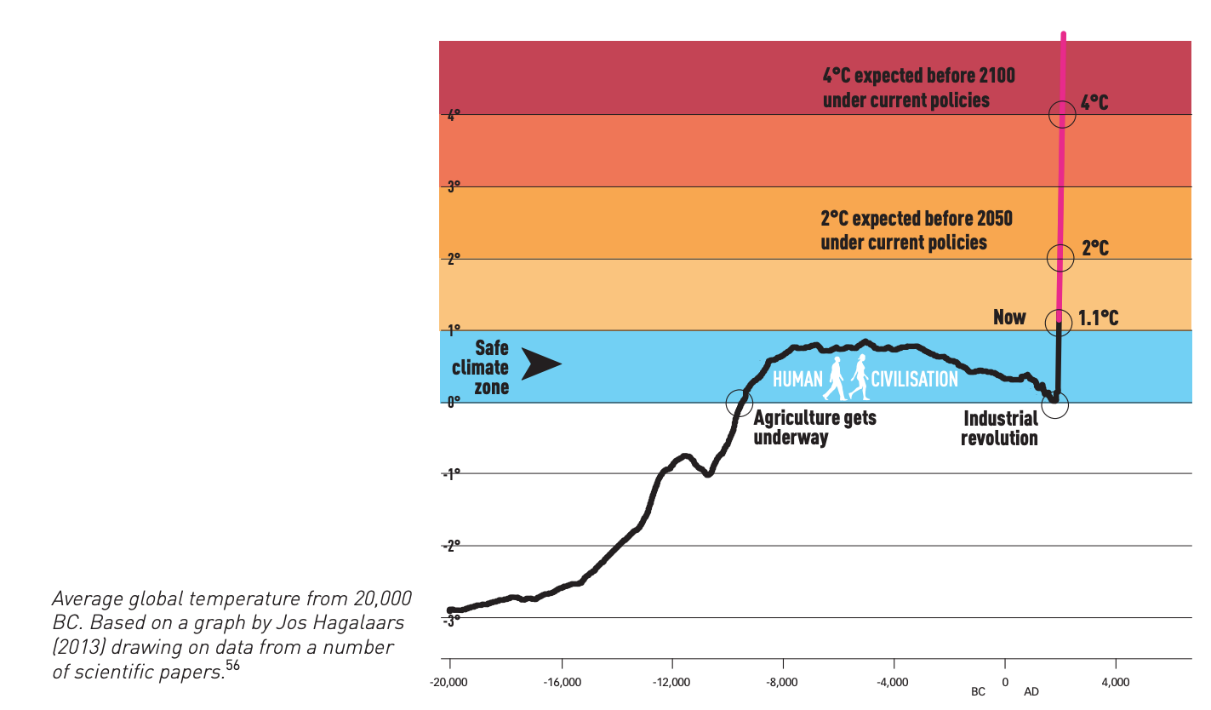
Where we are heading
Source: Don’t mention the emergency

Slide 14
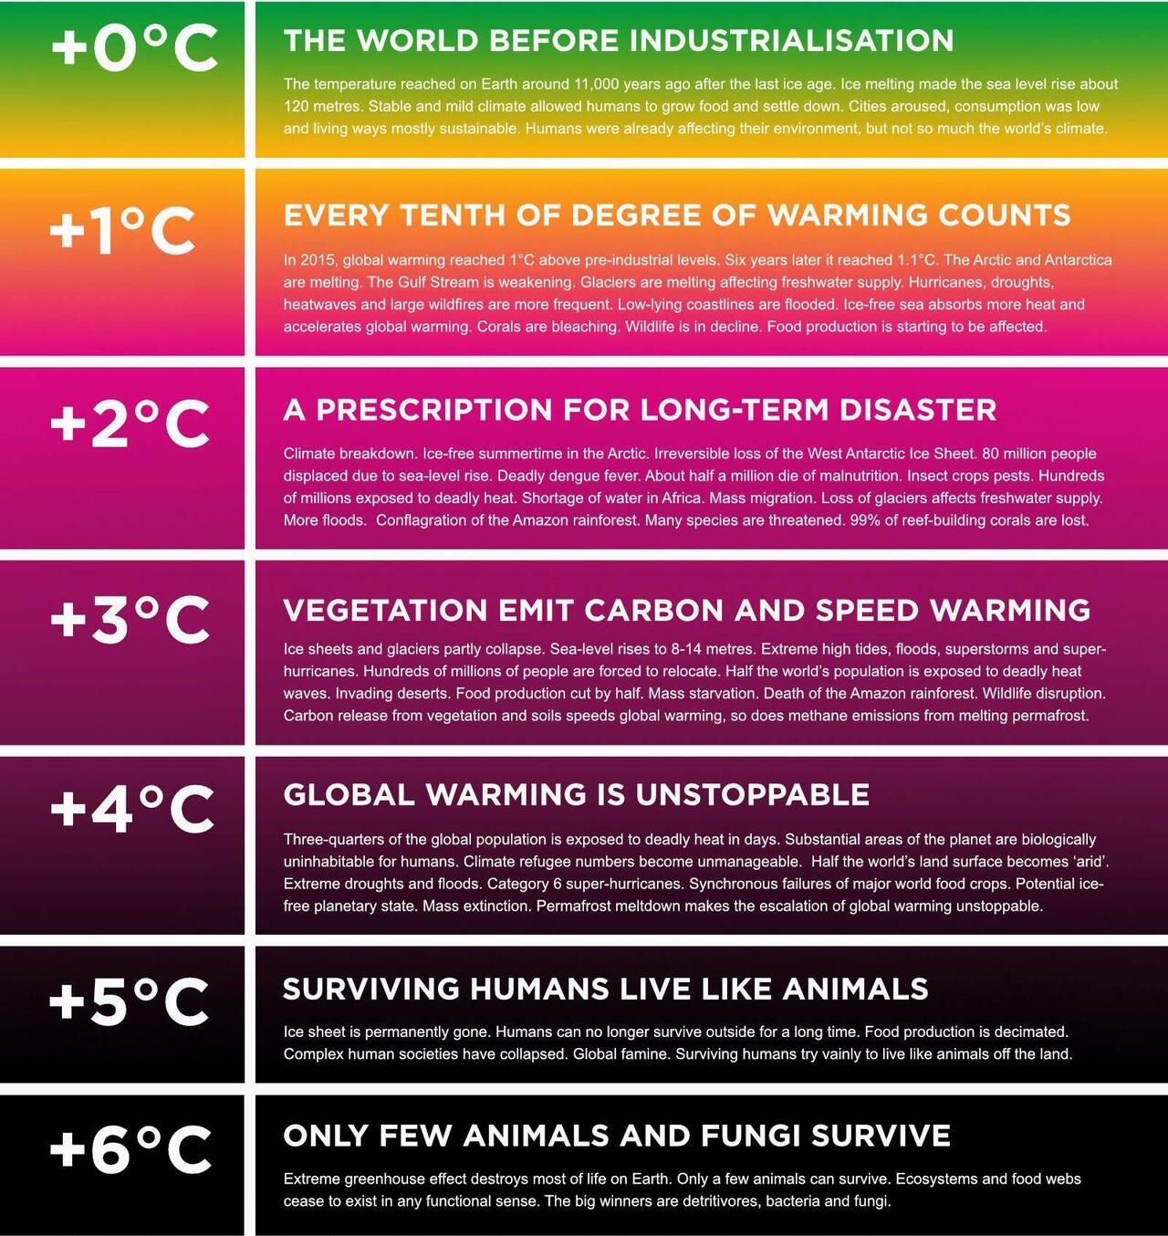
A few degrees, not much difference?
Source: All for climate

Slide 15
Phase 3
Emotions
‹#›

Slide 16
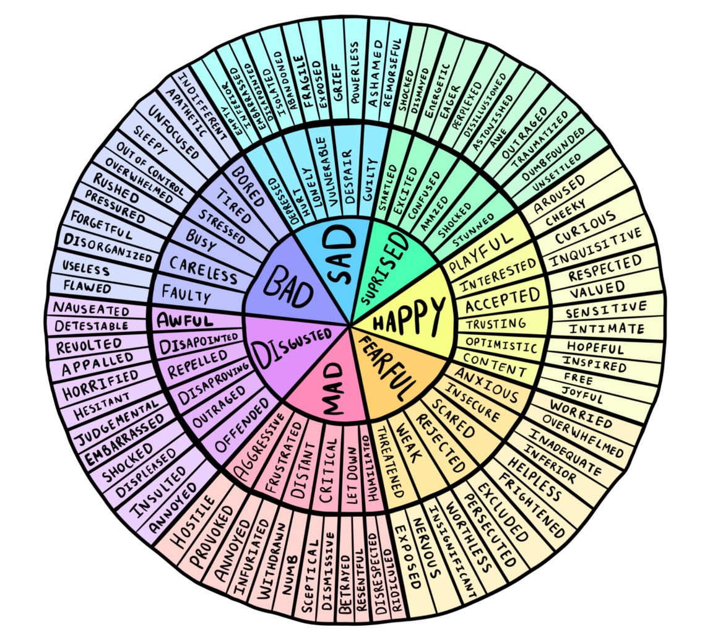
Facing the climate crisis, which emotion dominates?
  Sad
  Surprised
  Happy
  Fearful
  Mad
  Disgusted
Feelings Wheel by @selflovemattersbysteph
‹#›
Notes:
Idea 1: small group conversation for 5-10 min
Idea 2: for large group you can form duo and let them share their emotions for 2 min each. Come back as a whole group and let a few duo share their examples.

Slide 17
“
We need to address all of our emotions about the climate crisis, not only for our mental wellbeing but also to remove roadblocks to action. If we can’t look at how climate change makes us feel—along with the dilemmas and difficult choices we face—we can’t solve it.
“
– DR. RENEE LERTZMAN,
FOUNDER OF PROJECT INSIDE OUT
‹#›

Slide 18
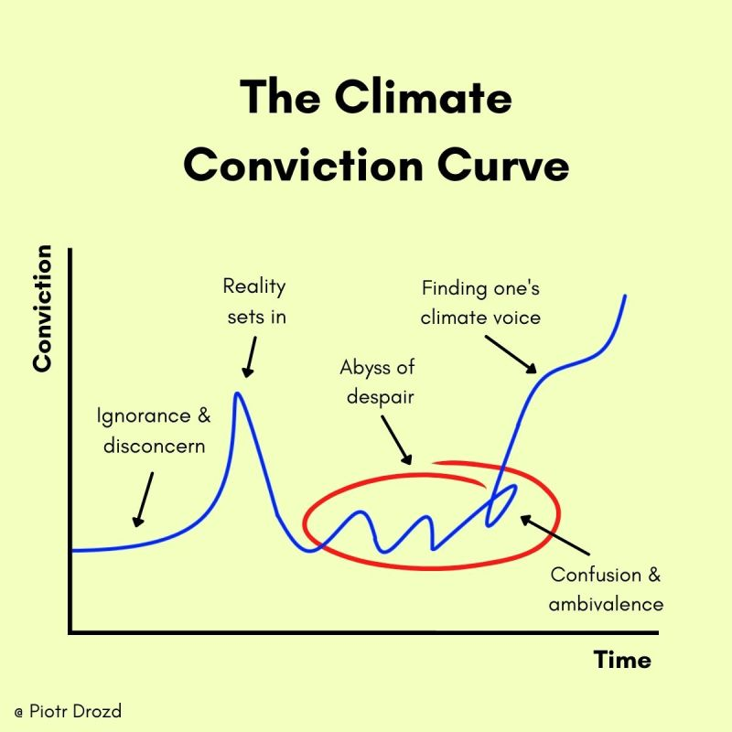
‹#›
Notes:
This is an an optional slide for: Emotions
[FACILITATION GUIDANCE]
Introduce the Typical Ross-Kubler change curve and the stages of grief
Denial > Shock > Anger > Bargaining > Depression > Acceptance > Commitment
Then introduce the climate conviction curve as a more realistic description of the stages of the climate journey ; it’s not linear !!

Slide 19
10 minute break
‹#›

Slide 20
Phase 4
Actions
‹#›

Slide 21
Activity 1 - Pop Quiz!
‹#›

Slide 22
Pop Quiz !
What was the share of fossil fuels (coal, oil, gas) in global energy consumption in 2020:
60%
78%
90%
Notes:
2009 data source: https://www.ren21.net/the-renewables-2022-global-status-report-in-150-words/
2022 data source: https://www.energyinst.org/statistical-review/insights-by-source

Slide 23
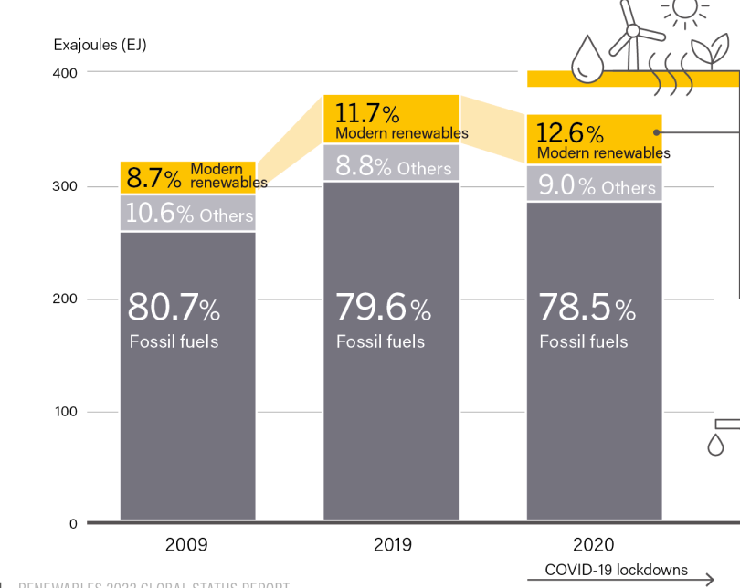


Share of fossil fuels (coal, oil gas) in global energy consumption in 2020:
60%
78%
90%
Notes:
2009 data source: https://www.ren21.net/the-renewables-2022-global-status-report-in-150-words/
2022 data source: https://www.energyinst.org/statistical-review/insights-by-source

Slide 24
Pop Quiz !
Average carbon footprint per capita in Australia?
25
Tonnes
15
Tonnes
5 Tonnes
Notes:
Carbon budget: Oxfam - https://www.oxfam.org/en/press-releases/carbon-emissions-richest-1-set-be-30-times-15degc-limit-2030

Slide 25
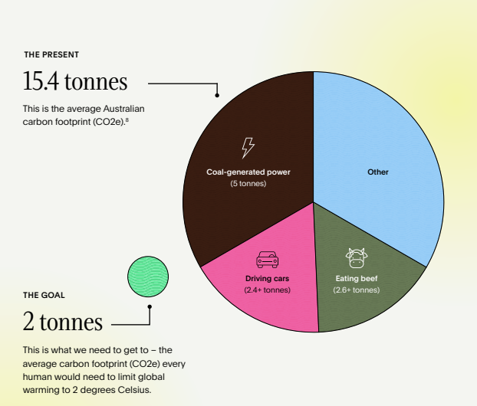

Average Australian carbon footprint:
5 T
15 T
25 T
Source: Australian Ethical

Slide 26
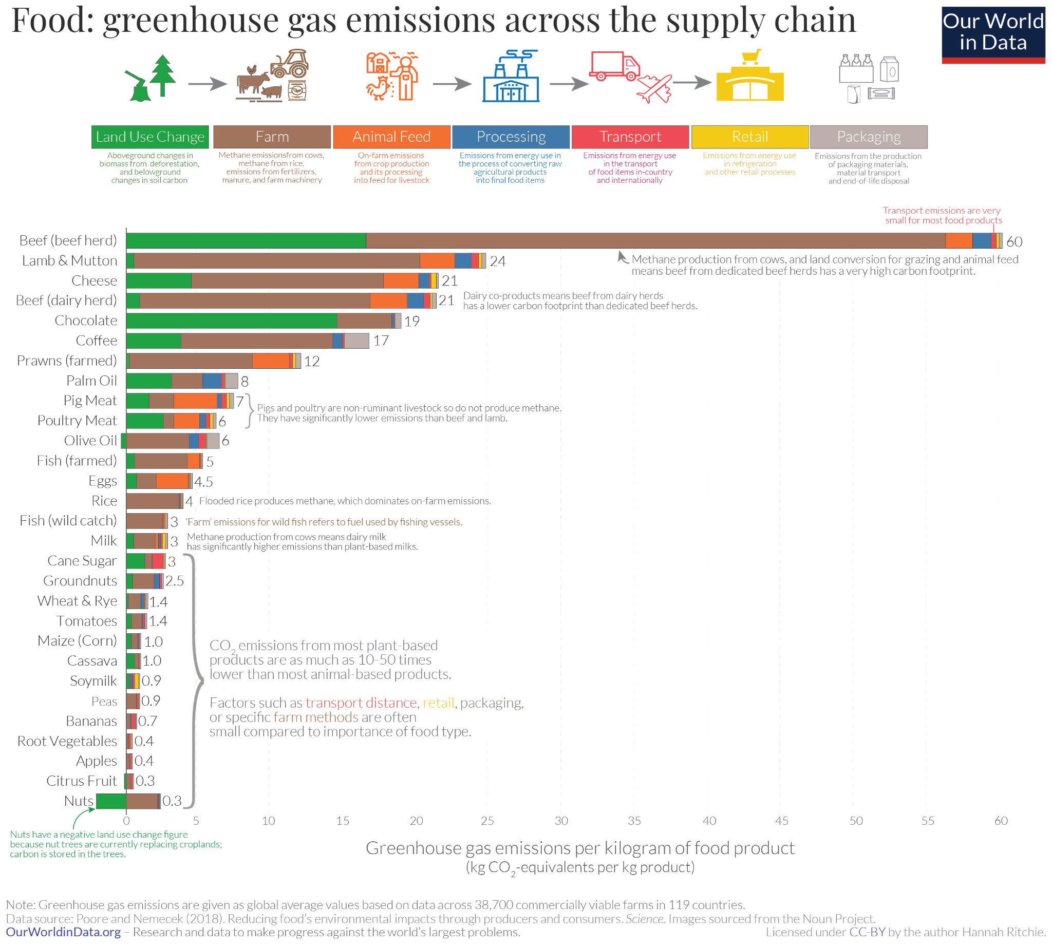

Slide 27
Pop Quiz !
What should be the individual carbon footprint to reach
the Paris Agreement and stay well below 2℃?
6 T
4 T
2 T
Notes:
Carbon budget: Oxfam - https://www.oxfam.org/en/press-releases/carbon-emissions-richest-1-set-be-30-times-15degc-limit-2030

Slide 28
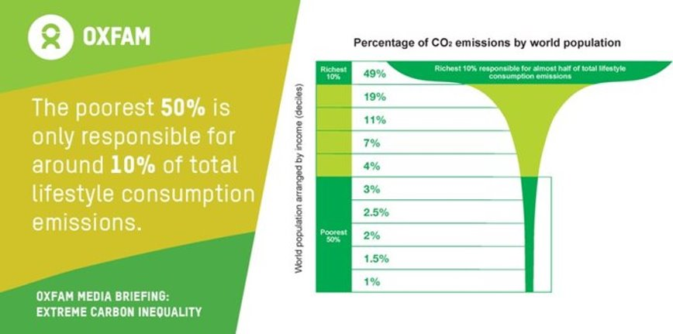
Average individual footprint to stay below 2 degrees warming (2050):
2 T
4 T
6 T
*On the pathway to reach the 2T target by 2050, 6T is the target we should be achieving by 2030 if we want to stay in line with the Paris agreement.
By 2030:
6 T*

Slide 29
Pop Quiz !
If SUVs were a country, how would they rank in terms of their contribution to emissions?
10th
6th
2nd
Notes:
Carbon budget: Oxfam - https://www.oxfam.org/en/press-releases/carbon-emissions-richest-1-set-be-30-times-15degc-limit-2030

Slide 30
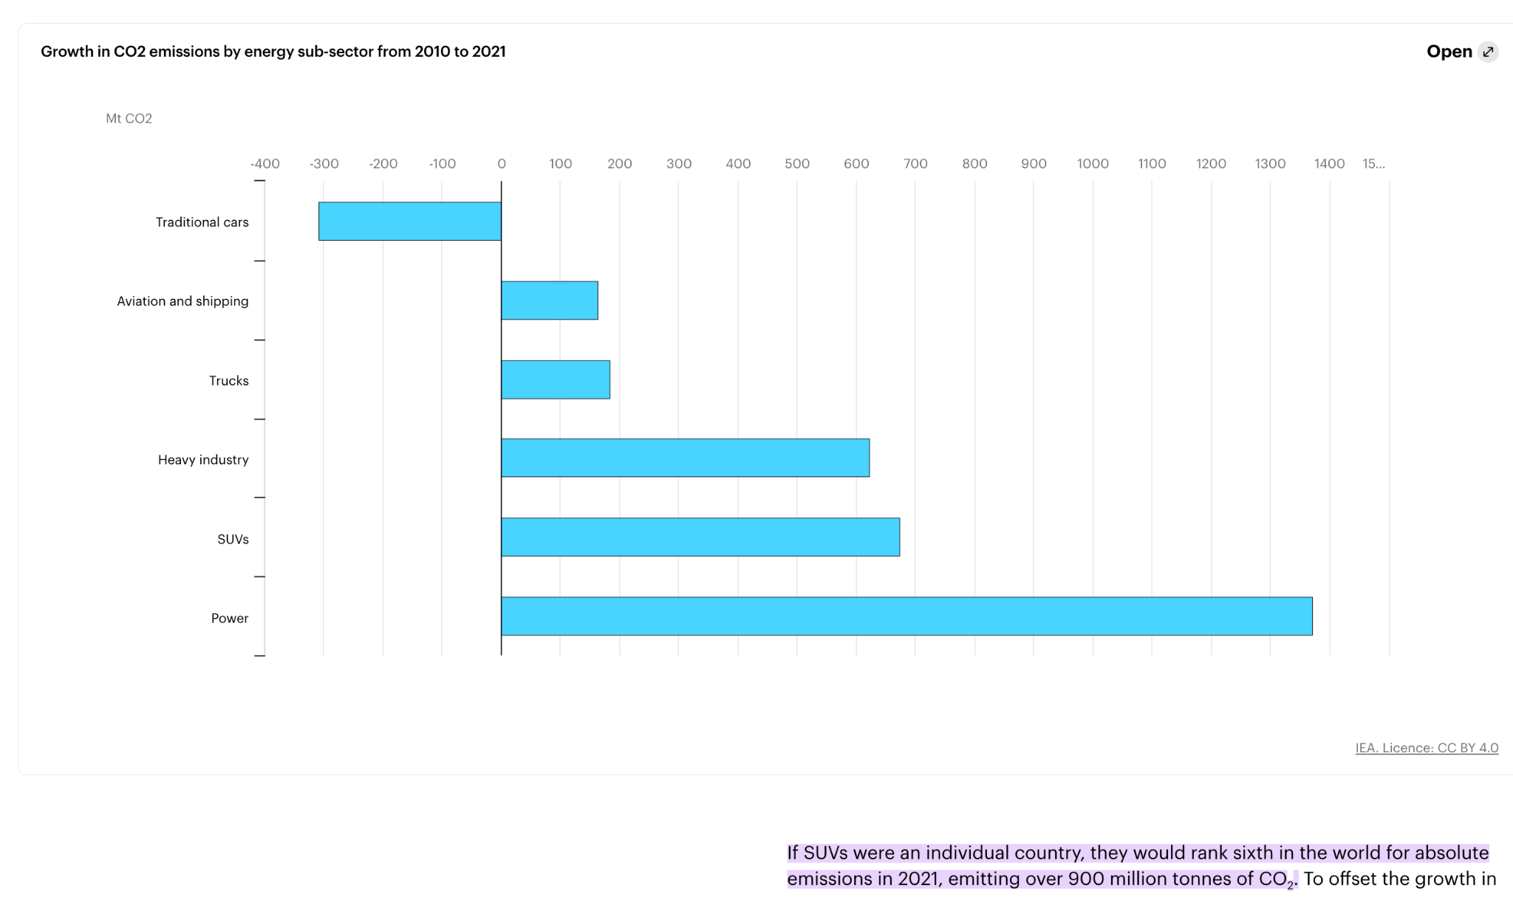
2nd
6th
10th
Source. International Energy Agency

Slide 31
Pop Quiz !
How much per person CO2 does an economy flight from Sydney to Bali emit?
1.2
tonnes
800 kg
300 kg
Notes:
Carbon budget: Oxfam - https://www.oxfam.org/en/press-releases/carbon-emissions-richest-1-set-be-30-times-15degc-limit-2030

Slide 32
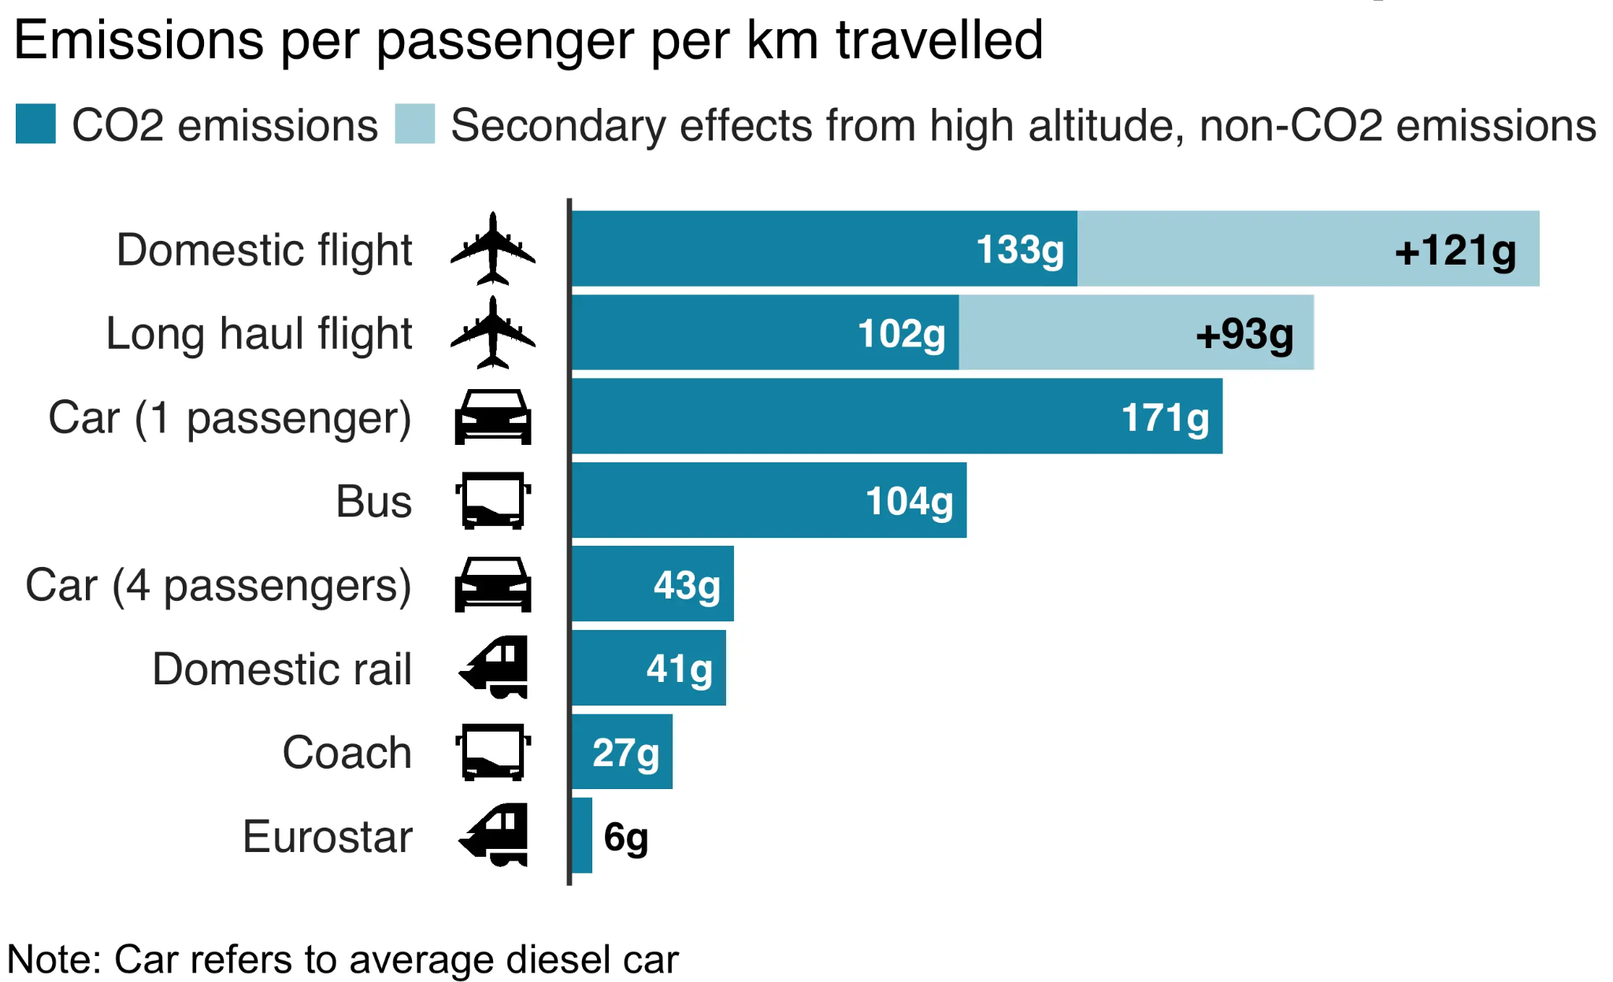
Source: BEIS / Defra Greenhouse Gas conversion factors 2019
300 kg
800 kg
1.2 tonnes
Flights – you can check your carbon footprint here: https://bonpote.com/en/flight-calculate-your-carbon-footprint-in-3-clicks/

Slide 33
Let’s unearth personal & collective actions we can take
Before we do, let’s consider context to taking action…
‹#›

Slide 34

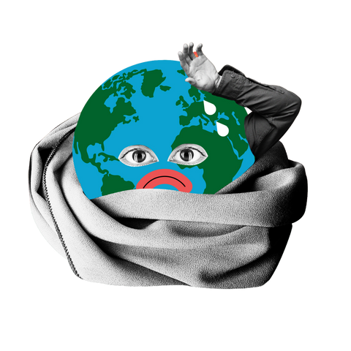


The triangle of inaction
Attributing responsibility to others and waiting for them to act doesn’t enable action
“What about politicians? All they care about is their own self-interest”
“Companies have the power of action but they just want to maximise profits”
People wouldn’t vote for tough regulations that impact their lifestyles
Consumers have to make choices. We produce what they demand.
We can’t change the markets, companies have more power to change
Governments must set new policies. I can’t act if my competitors don’t do it too.
Source: Pierre Peyretou
‹#›

Slide 35
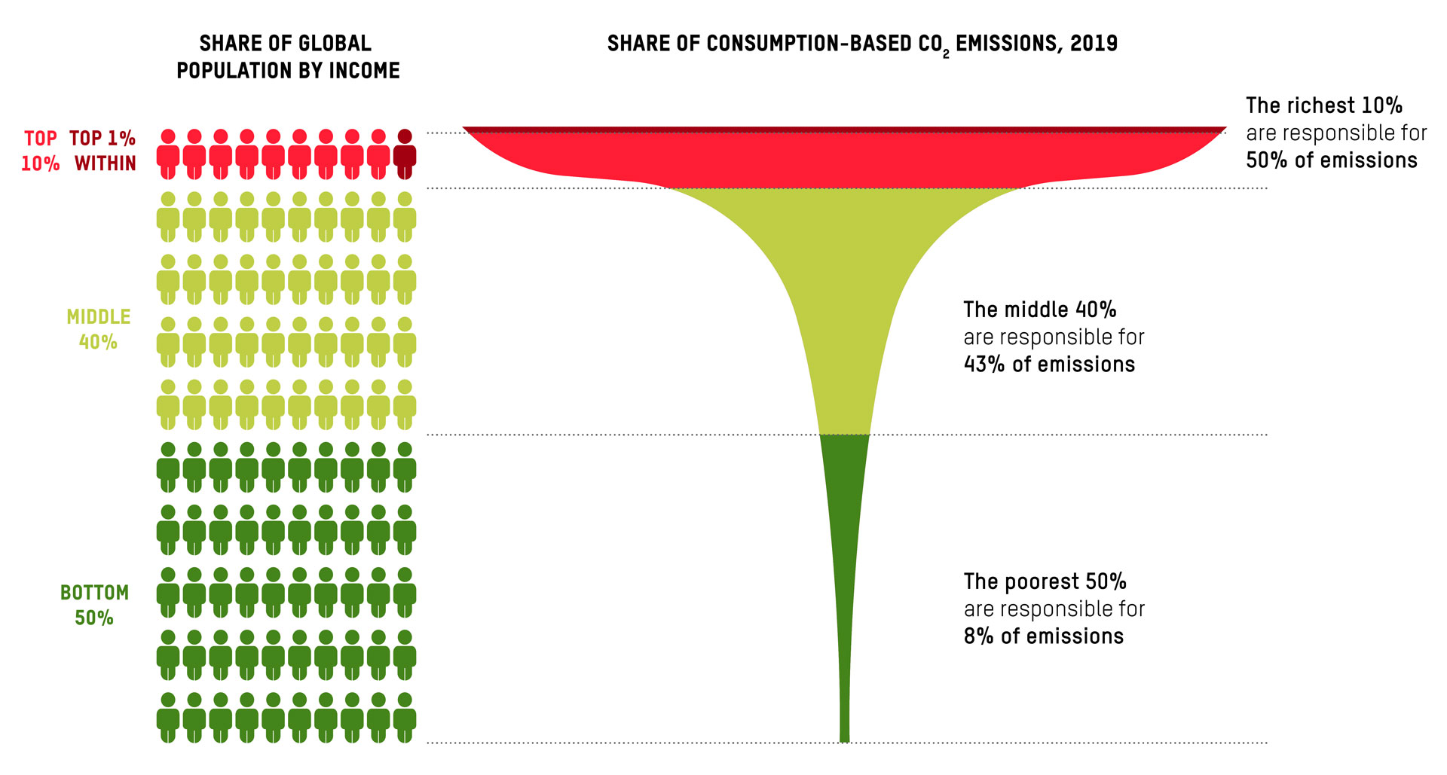
Empirical studies are confirming link between C02 emissions and an individual’s lifestyle consumption based on their level of income
Source: Oxfam climate inequality report

Slide 36
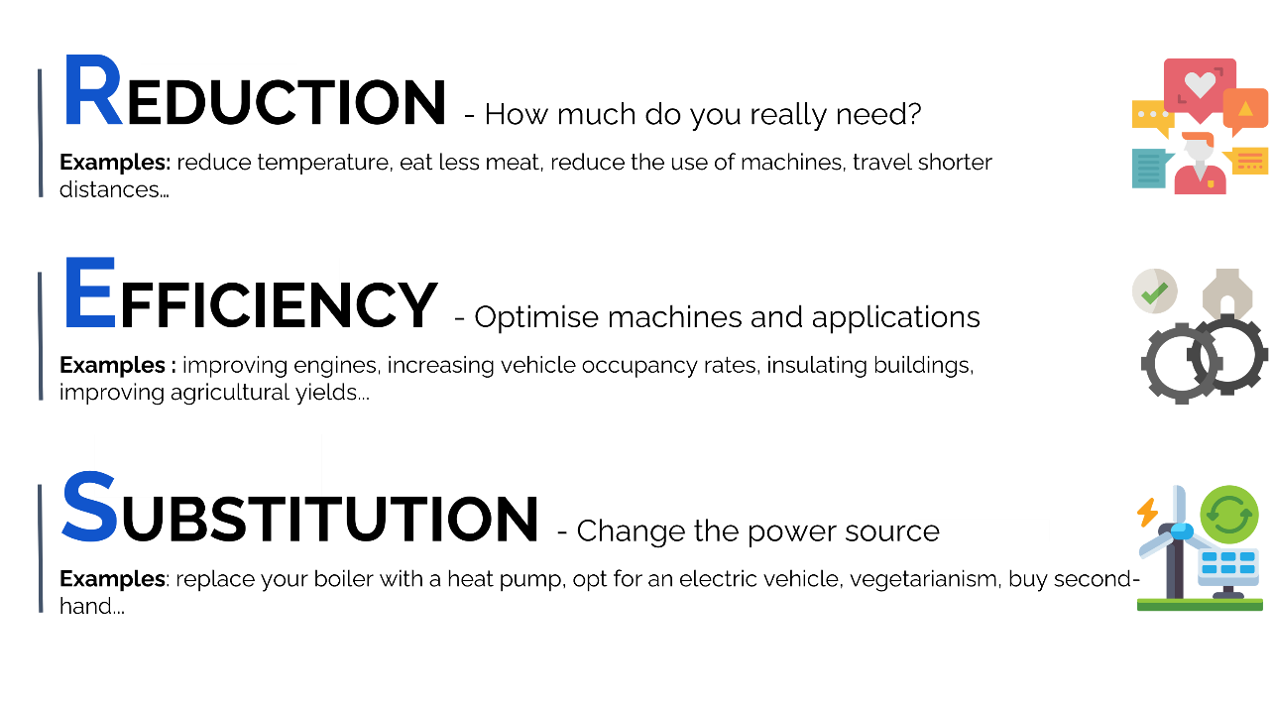
Classifying actions to reduce Co2 emissions
‹#›

Slide 37
Activity 2 - Personal action
‹#›

Slide 38
Mind map
What are your Climate Superpowers?
Citizen
Collective Actions that move the system
Consumer
How you live and what you buy
Professional
Taking climate action at work and influencing your workplace
Me
Investor
Where and how your money is invested
Role Model
How you influence others an help shift society
‹#›

Slide 39
Mind map - Climate Superpowers
1- Individual brainstorm - 5 minutes
2- Group brainstorm - 10 minutes
Split in 2 groups of 3/4
Gather as many ideas as possible
Think big and out of the box 📦 !
3- Pitch + Discussion - 5 minutes
Pitch in 60 seconds the 2 most impactful ideas to our group.
‹#›

Slide 40
Activity 3 - Collective action
‹#›

Slide 41
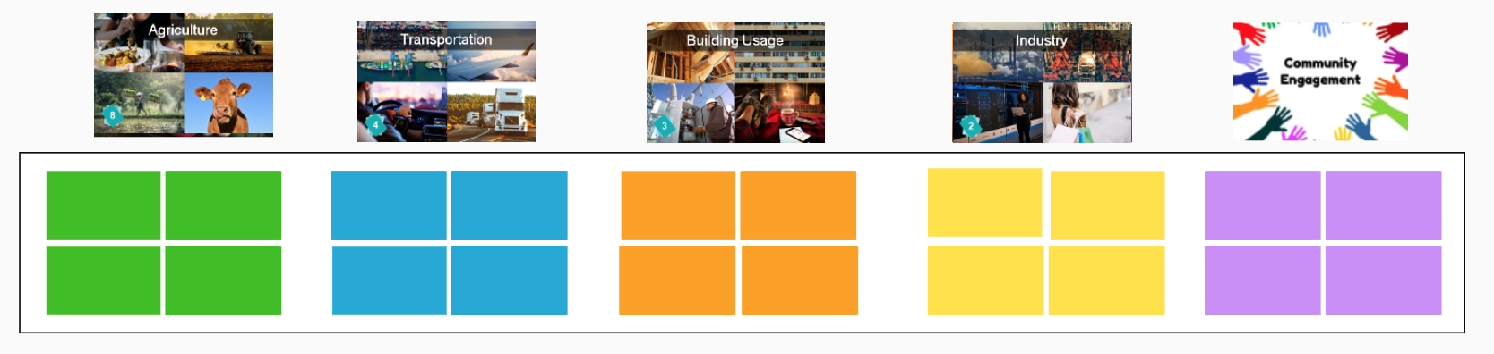
Let’s go back to our Fresk
Think about levers of action to reduce the impact of human activities …
1. ➔ Write 1 or 2 ideas on Post-It notes for each of the below human activities
2. ➔ Let’s lay out these ideas according to framework below:
Collective
3. ➔ Having laid out Post-It notes onto framework:
Which of these do you think are the most impactful on reducing emissions?
Which of these would you be ready to start doing (or are already doing)?
Classify your actions according to Reduction (R) / Efficiency (E) / Substitution (S)
Difficult
Easy
Individual
‹#›

Slide 42
Commitment
What’s an action to address climate change you’re now definitely 100% committed to do?
Ideas:
Perhaps an action from our earlier activities? E.g. an individual or collective action?
Taking up an enjoyable activity that has no additional CO2 impact? E.g. walking, dreaming, reading, playing acoustic music…
Help spread the word of Climate Fresk? Ask my friends or my employer organisation to participate in a workshop? Become a Climate Fresk Facilitator?
‹#›
Notes:
[FACILITATION GUIDANCE]
Option 1
Ask “what are 3 things that you’re looking to explore as a result of your participation in this workshop”?
Option 2
Ask participants to take a piece of paper, fold it in two, then fold it in two again
Give them the 4 following prompts to write on each corner of the page:
Today I learnt …
Something that feels different is…
My next step is…
I will need support with…

Slide 43
Reflection
What’s your biggest take-away from this workshop?
E.g. are you reassessing your self-assessments scores (between 1 and 5) made at the beginning of workshop?
‹#›
Notes:
[FACILITATION GUIDANCE]
Option 1
Ask “what are 3 things that you’re looking to explore as a result of your participation in this workshop”?
Option 2
Ask participants to take a piece of paper, fold it in two, then fold it in two again
Give them the 4 following prompts to write on each corner of the page:
Today I learnt …
Something that feels different is…
My next step is…
I will need support with…

Slide 44
Close
That’s it! You’ve made it!
Thank you!
Give ourselves a big clap!
And don’t forget to register your attendance ☺
‹#›

Slide 45
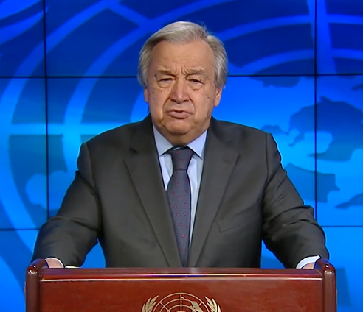

António Guterres
(UN Secretary-General)
“Now is the time to turn rage into action.
Every fraction of a degree matters.
Every voice can make a difference.
And every second counts.”
‹#›

Slide 46
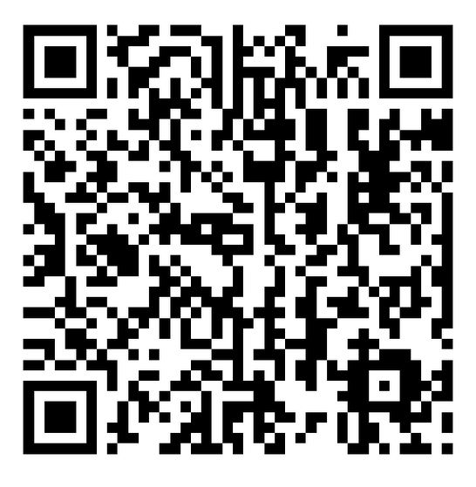
Feedback is a gift
‹#›
Notes:
[FACILITATION GUIDANCE]
Option 1
Ask “what are 3 things that you’re looking to explore as a result of your participation in this workshop”?
Option 2
Ask participants to take a piece of paper, fold it in two, then fold it in two again
Give them the 4 following prompts to write on each corner of the page:
Today I learnt …
Something that feels different is…
My next step is…
I will need support with…

